Slide 1

Cyclistic Bike Share
Casual Riders vs Annual Members

Slide 2
Where are we now?
We have grown to a fleet of 5,824 bicycles in a network of 692 stations across Chicago
Three pricing plans
single-ride passes
full-day passes
annual memberships.
Customers who purchase single-ride or full-day passes are referred to as casual riders.

Slide 3
Moving Forward
Our finance analysts have concluded that annual members are much more profitable than casual riders

Slide 4
Our Goal
Design marketing strategies aimed at converting casual riders into annual members

Slide 5
My Focus
Discover how annual members and casual riders use Cyclistic bikes differently

Slide 6
Data

Slide 7
Data Structure
The data is from Jan 2023 to Dec 2023
The following fields were used to analyze the data:
Customer type
Total rides
Average ride duration
Bike type
Start Time
Day of the week
Month
Starting latitude
Starting longitude

Slide 8
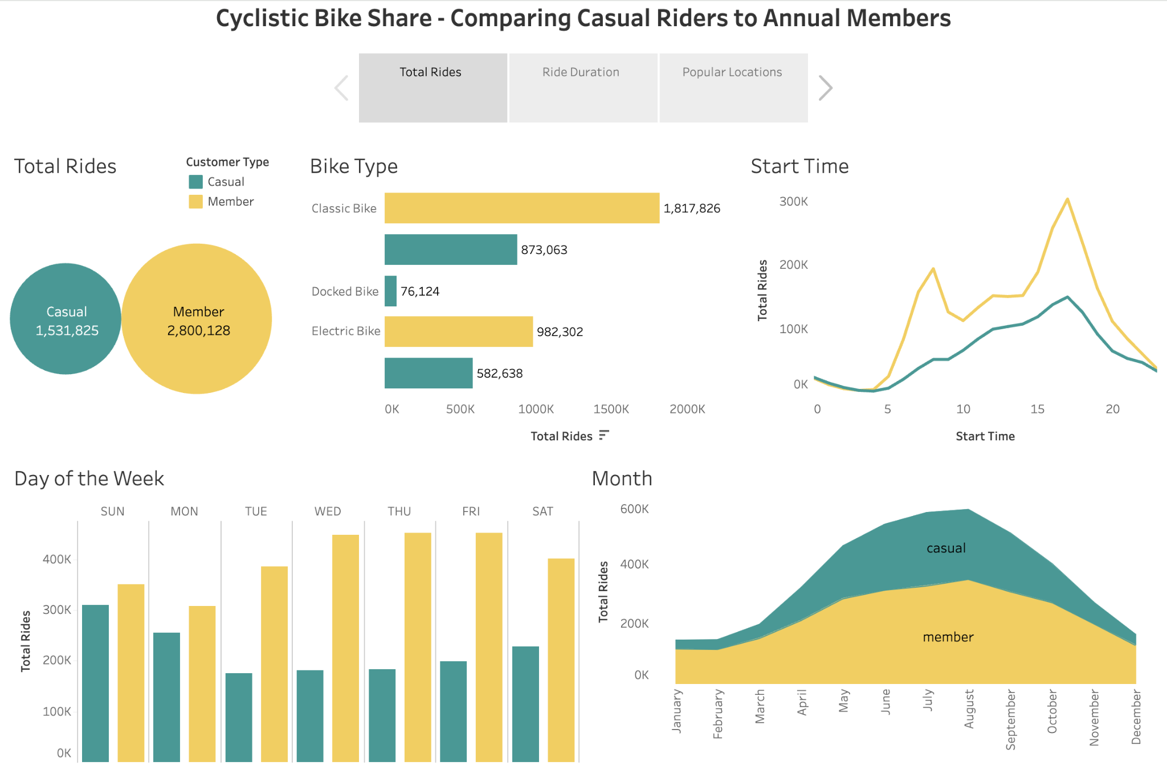

Slide 9
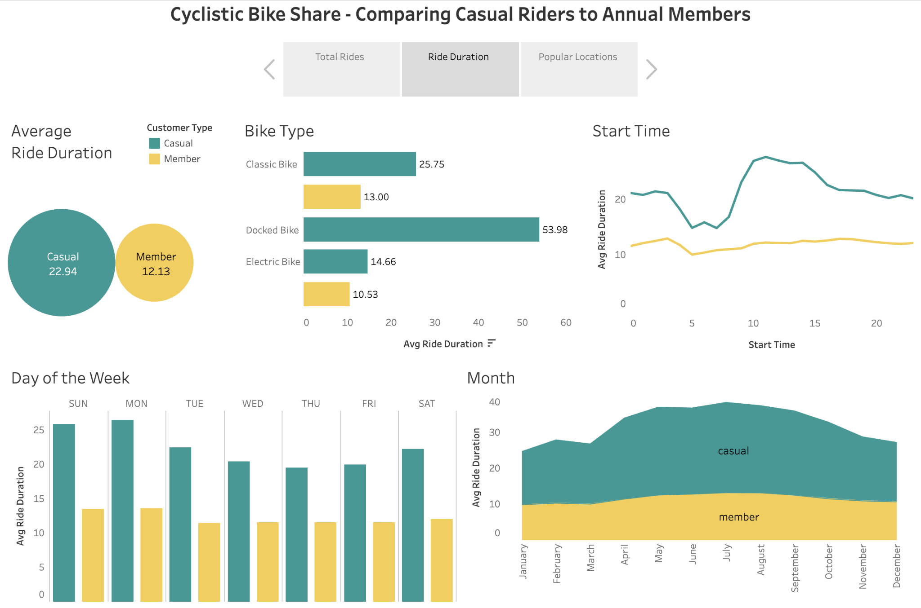

Slide 10
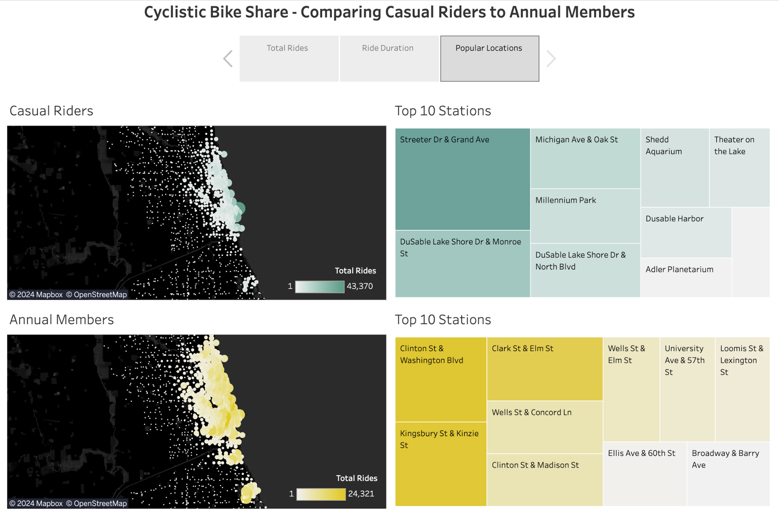

Slide 11
Key Differences

Slide 12
Longer trips
Casual riders average 10 more minutes per trip
The average ride time is higher in every category for casual riders

Slide 13
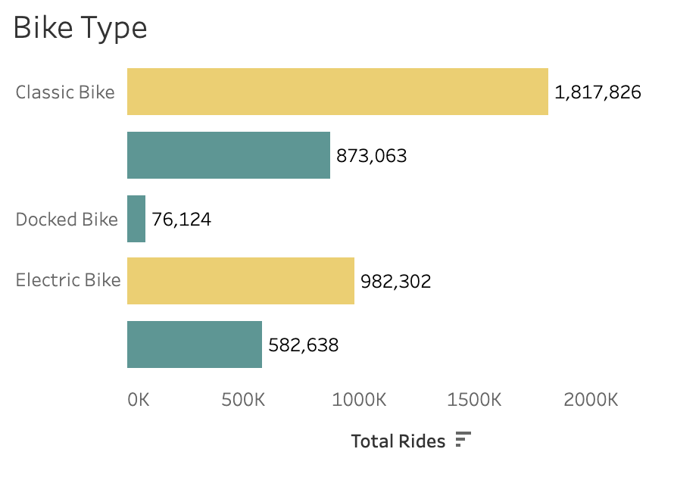
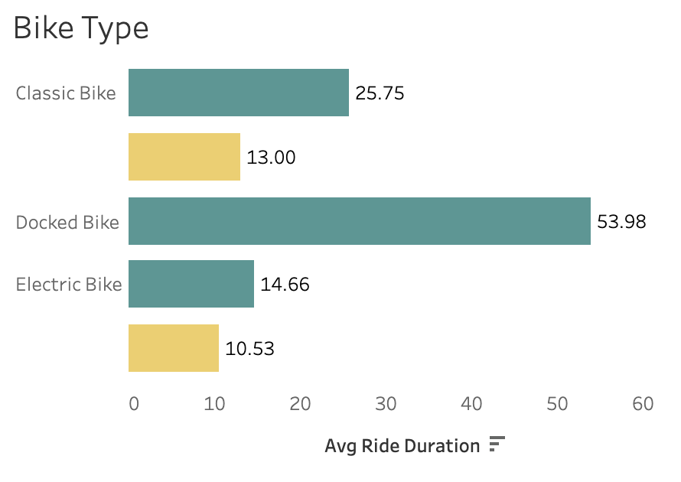
2.) Docked bikes
Only casual riders use docked bikes
Docked bikes are used for very long rides

Slide 14
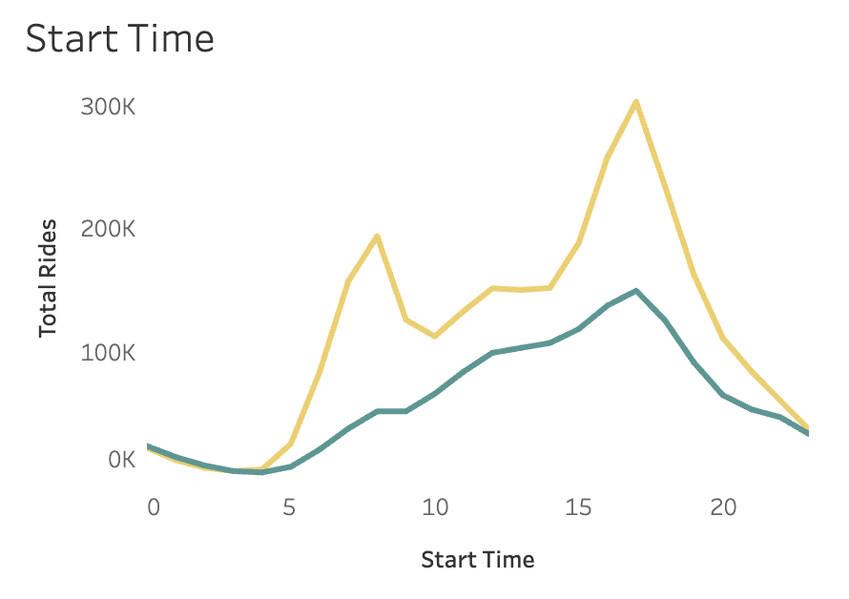
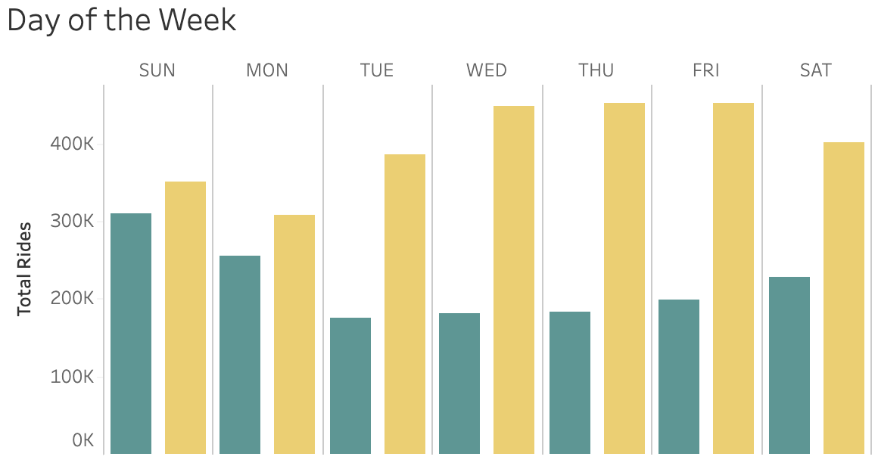
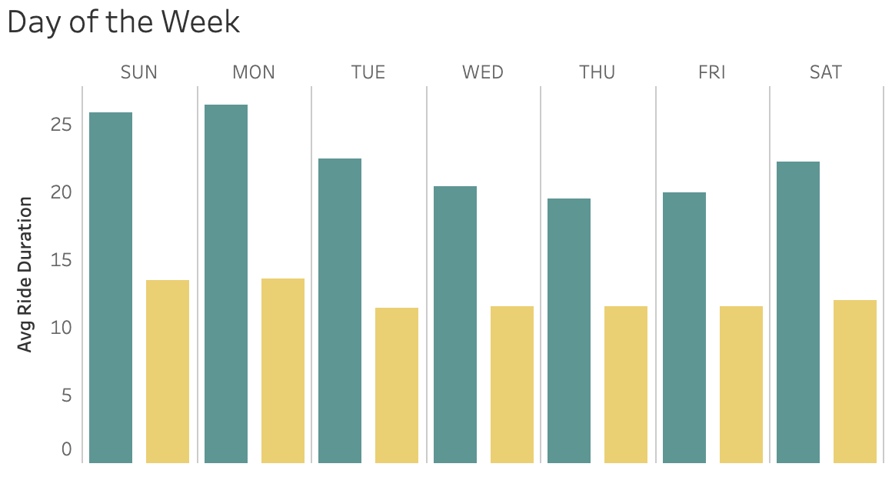
3.) Riding recreationally
Most casual rides happen after normal work hours
Saturday, Sunday and Monday are the most popular days for casual riders
Ride duration drops during the week for casual riders

Slide 15
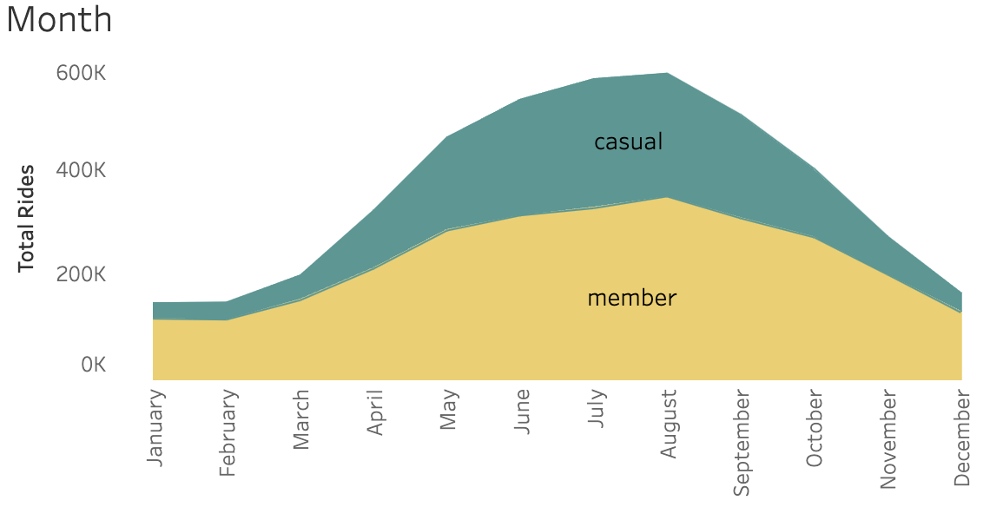
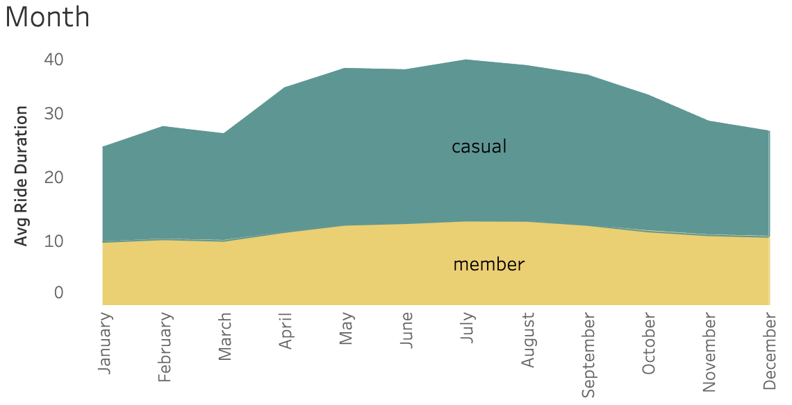
4.) Seasonal riders
Casual riders grow at a faster rate during the spring months
They decrease at a faster rate as the weather gets colder
Significant spike in ride duration at the beginning of spring for casual riders

Slide 16
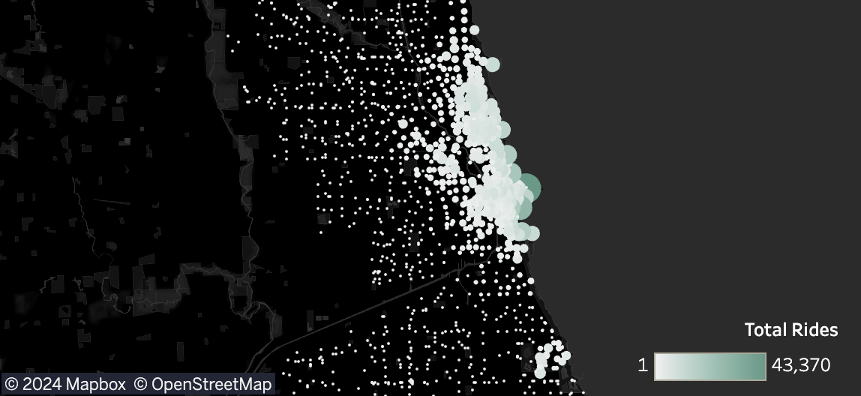
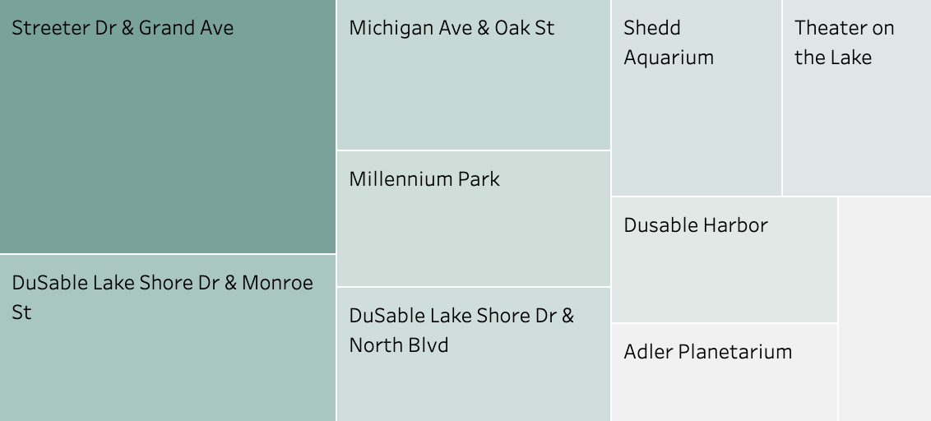
5.) Popular Stations
Casual riders congregate around a few popular stations
Streeter Drive & Grand Avenue is by far the most popular station
Annual members are much more evenly distributed

Slide 17
Recommendations

Slide 18
Marketing campaigns at popular stations
Focusing marketing efforts here would maximize our outreach.

Slide 19
Spring and summer promotions
Offering promotions during peak riding seasons is when the offers will be most attractive

Slide 20
Host Events promoting recreational riding
Fundraisers or friendly competitions will allow causal riders to relate more to the company, making it more likely that they will invest in membership.
A great avenue for promoting membership by providing incentives four annual members.

Slide 21
Weekend membership
Casual weekend riders are more likely to buy a discounted membership that only provides them with weekend rides.

Slide 22
Seasonal memberships
Seasonal riders are more likely to buy a discounted membership that only provides them with seasonal rides.

